Slide 1
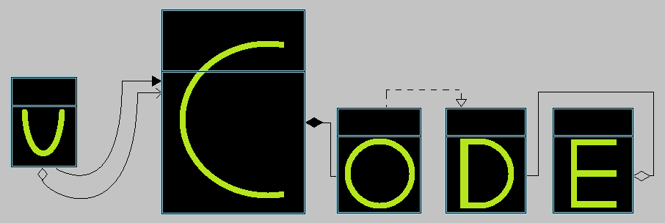
UML and Code Generator
https://github.com/dstoeg/Uml2CodeTool

Slide 2

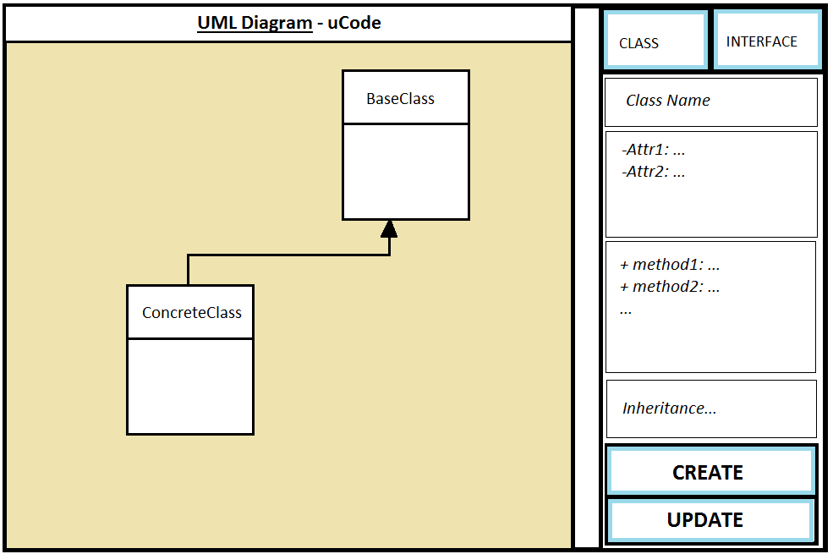

Slide 3
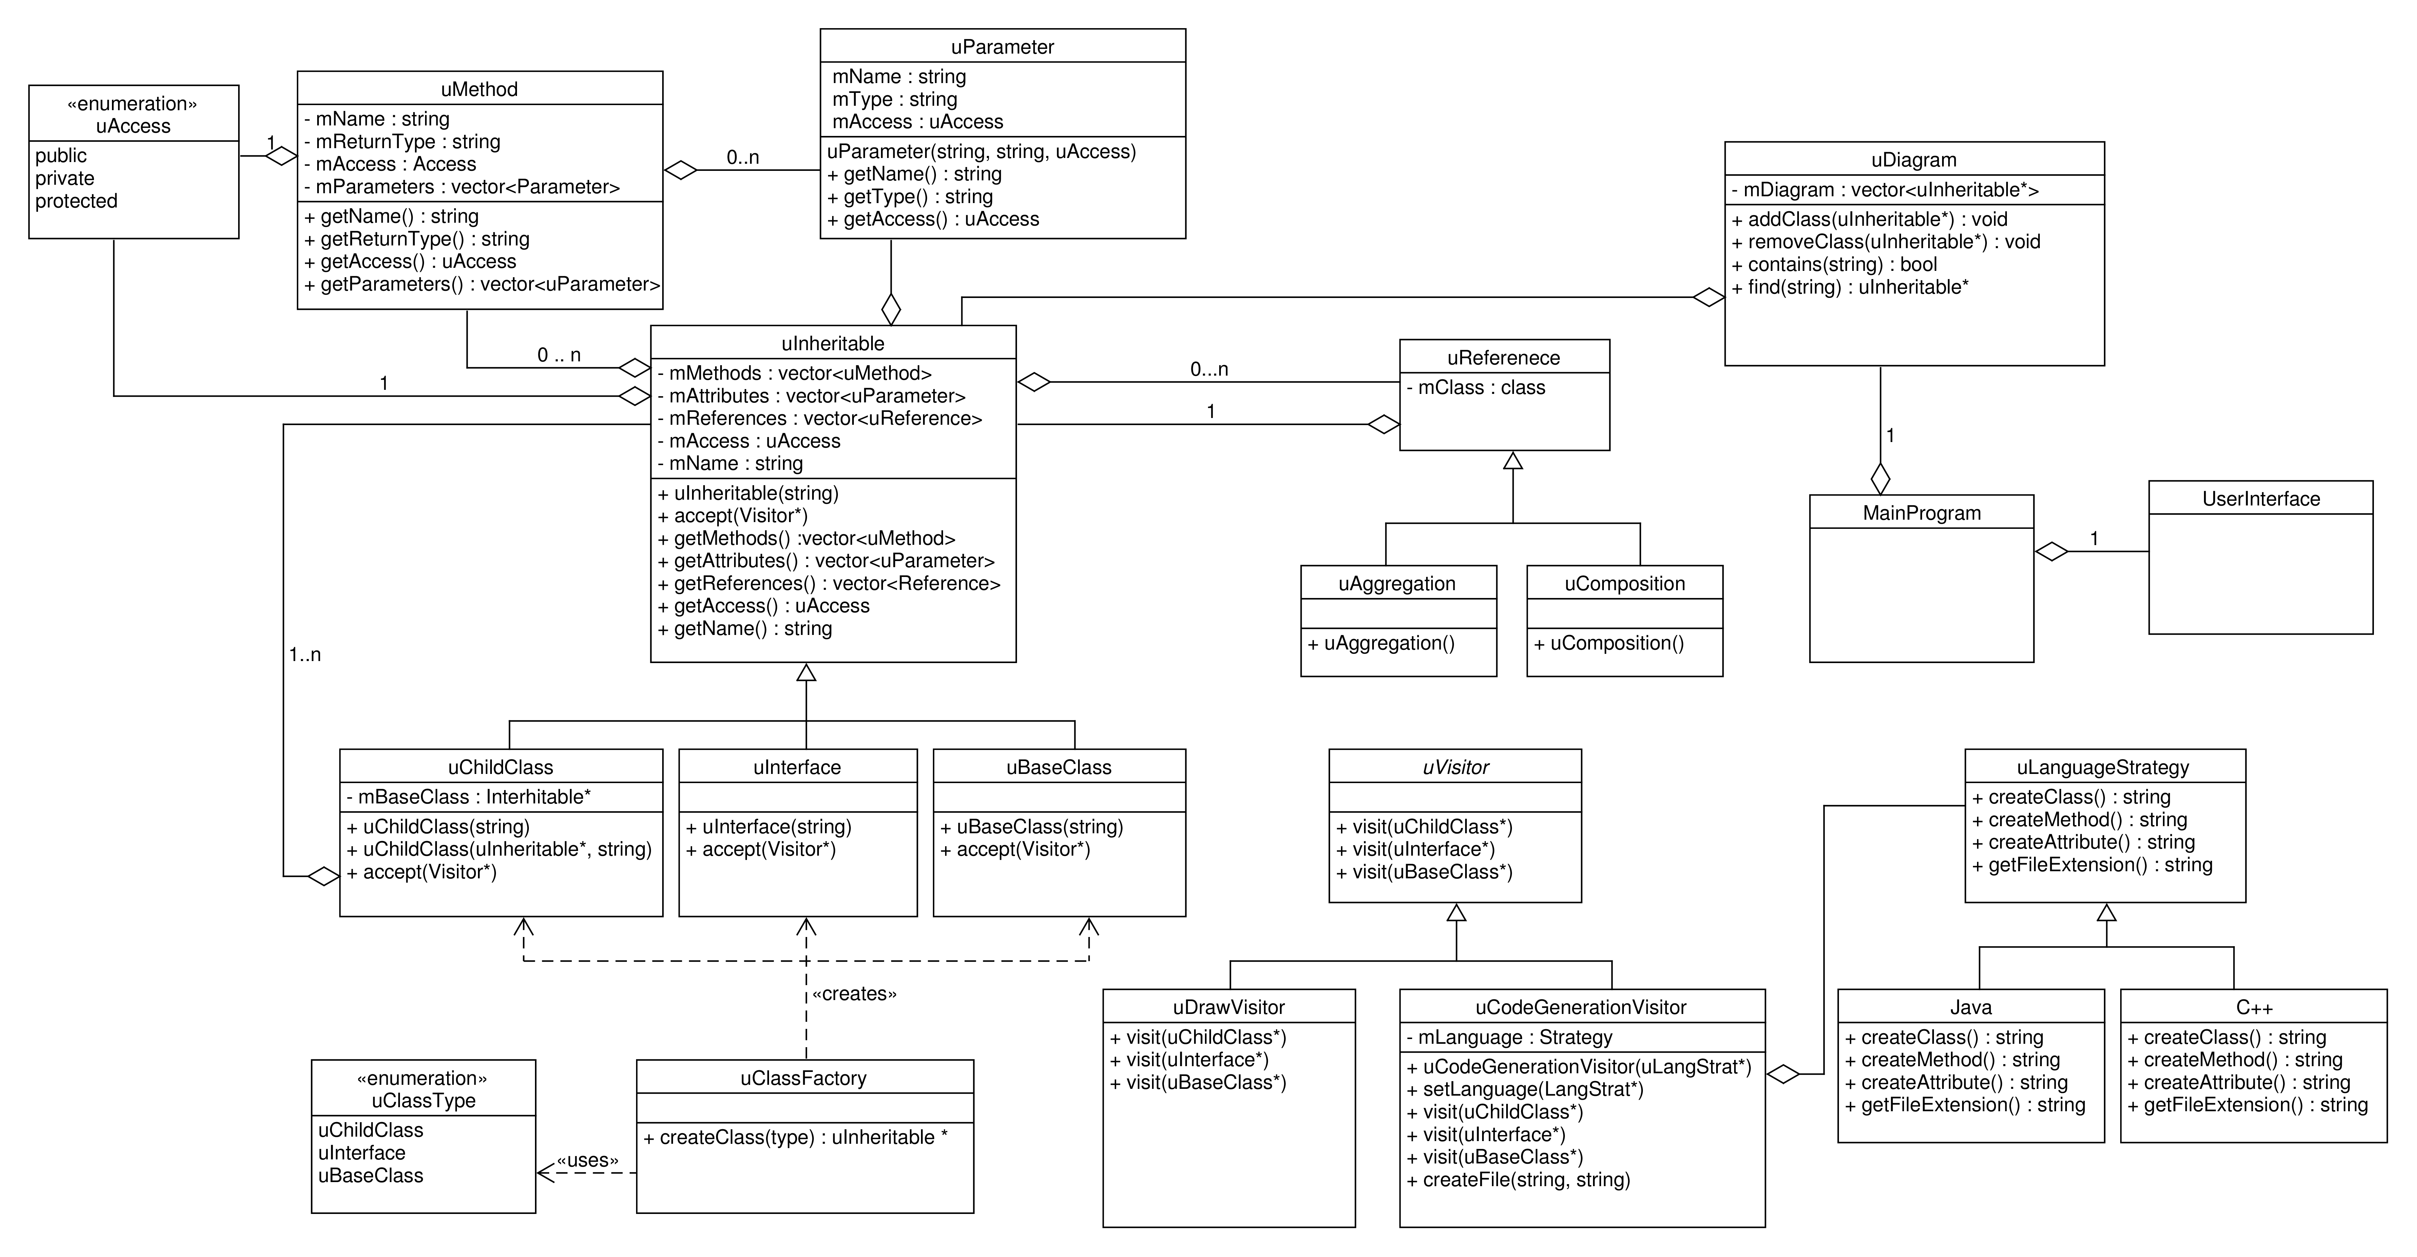

Slide 4
Environment
C++ (POSIX)
QT Creator 3.5
QT Library 5.3 (GUI)
QtTest
Git

